Slide 1
Determining a Location for a new restaurant in Troy, AL
Sydney Johnson
IBM Data Science Capstone

Slide 2
Introduction
The city of Troy, AL is a small college town located in South-Eastern Alabama. Troy is divided by a major highway that leads directly to the beach. Because of this, Troy has several fast-food options for those passing through, but not many sit-down restaurant options for the residents and university students of Troy.

Slide 3
Business Problem
Levi Smith, a young entrepreneur, is looking to open a restraint that can fill this void in the community. He has a concept for a menu and bar that would attract the locals and college students alike. His main concern now is location. He would like his restaurant to stand apart from all of the fast food and chain restaurants in Troy. He also need the location to be somewhere that college students and local families can easily access. Mr. Smith believes that the best location would be somewhere outside of the main hub of food options, but not somewhere where it is the only restaurant around.

Slide 4
Data
For this project, I will be primarily using Four Square API. Four Square API is a database that provides tons of information about venue location. It will allow me to find all restaurant’s in the area and their locations. I will use only the information of restaurants located within city limits as Mr. Smith wants his restaurant to be accessible by the public and college students alike. The data provided by Four Square API will allow me to plot the area’s existing restaurants in order to determine a location for Mr. Smith’s restaurant that meets all of his criteria.

Slide 5
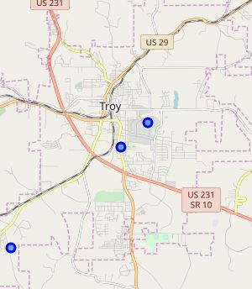
Methodology
Gather Zip Code Coordinates using pgeocode, put into data frame.
Use Folium to visualize Zip Codes
Use FourSquare API to gather restaurant info
Create a data frame of restaurant venues, merge with zip codes
Use K-Means Clustering to cluster restaurants into Zip Code zones
Analyze zones

Slide 6
Results
After clustering and visualizing my data, I can explore the clusters to see where most of the restaurants are located. The most restaurants are located in the cluster for the Zip Code 36081. The second greatest amount of restaurants are located in the Zip Code cluster of 36082. The zip code with the least amount of restaurants is 36079. With this knowledge, the new restaurant owner will be better equipped to make a decision on where his new restaurant might thrive best.

Slide 7
Thank you!!

